Slide 1
an International CBSE Finger Print School
Coimbatore
GRADE-XI
UNIT 1 –
TOPIC 1 –

Slide 2
CONSIDER AN EXAMPLE
Barebones of the python program:
Comments –Begin with # ,Inline comments ,Multi line comments
Statements
Indentation
Expressions
Function
Blocks and indentation

Slide 3
CONSTRAINTS
Variables and assignments:
Variables:
Named labels,whose values can be used and processed during program run are called variables.
Lvalue:Expressions that can come on the lhs(left hand side) of an assignment.
Rvalue:Expressions that can come on the rhs(right hand size) of an assignment.
Multiple Assignments:
1.Assigning some value to multiple variables:
a=b=c=10
2.Assigning multiple values to multiple variables:
x,y,z=10,20,30

Slide 4
.
Variable Definition:
print(x)
x=20
Print(x)
x=0
print(x)
x=20
print(x)

Slide 5
Dynamic Typing x=10 print(x) x=“Hello World” print(x) Output: 10 Hello world

Slide 6
Type(): a=10 type(a) <class ‘int’> a=20.5 type(a) <class ‘float’> >>a=“hello” type(a) print(a)

Slide 7
Output through print() function print(“hello”) # a string print(17.5) # a number print(3.14159*(r*r)) #the result of a calculation print(“I\’m”,12+5,”years old.”) #multiple comma separated expressions

Slide 8
Dynamic Typing x=10 print(x) x=“Hello World” print(x) Output: 10 Hello world

Slide 9
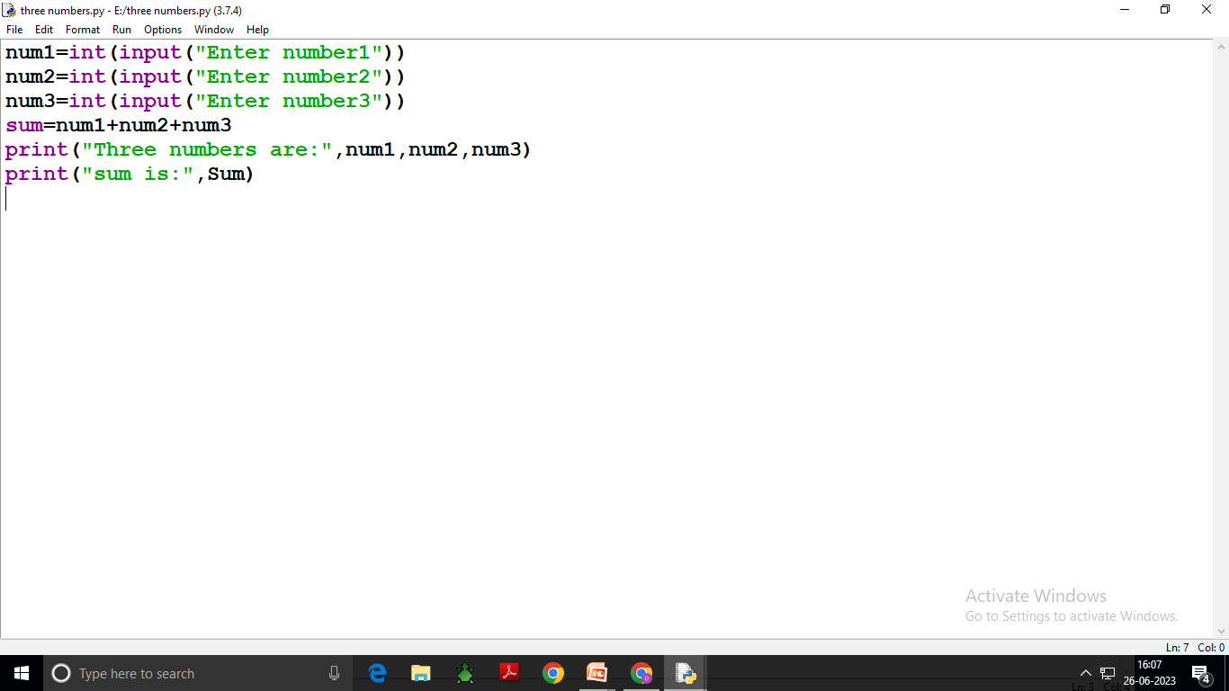

Slide 10
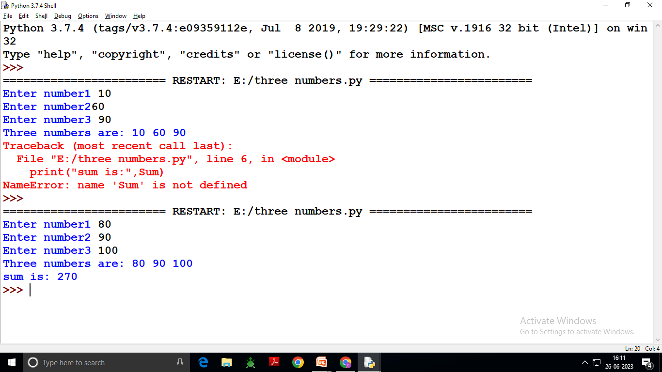

Slide 11
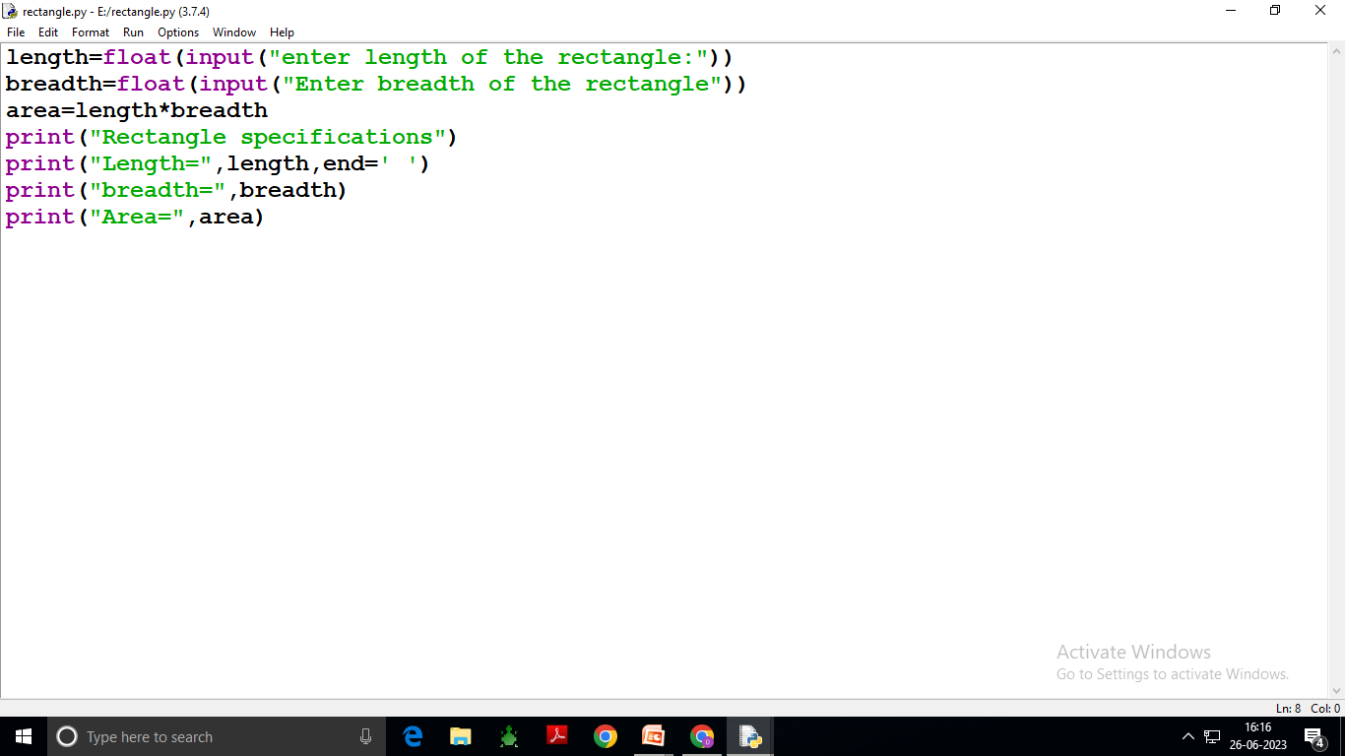

Slide 12
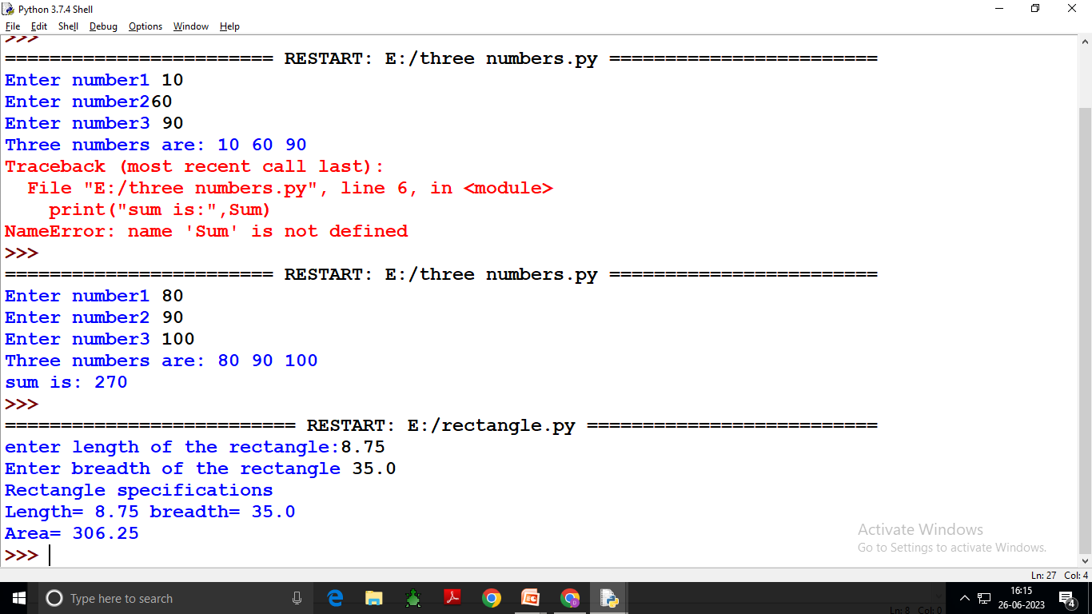

Slide 13
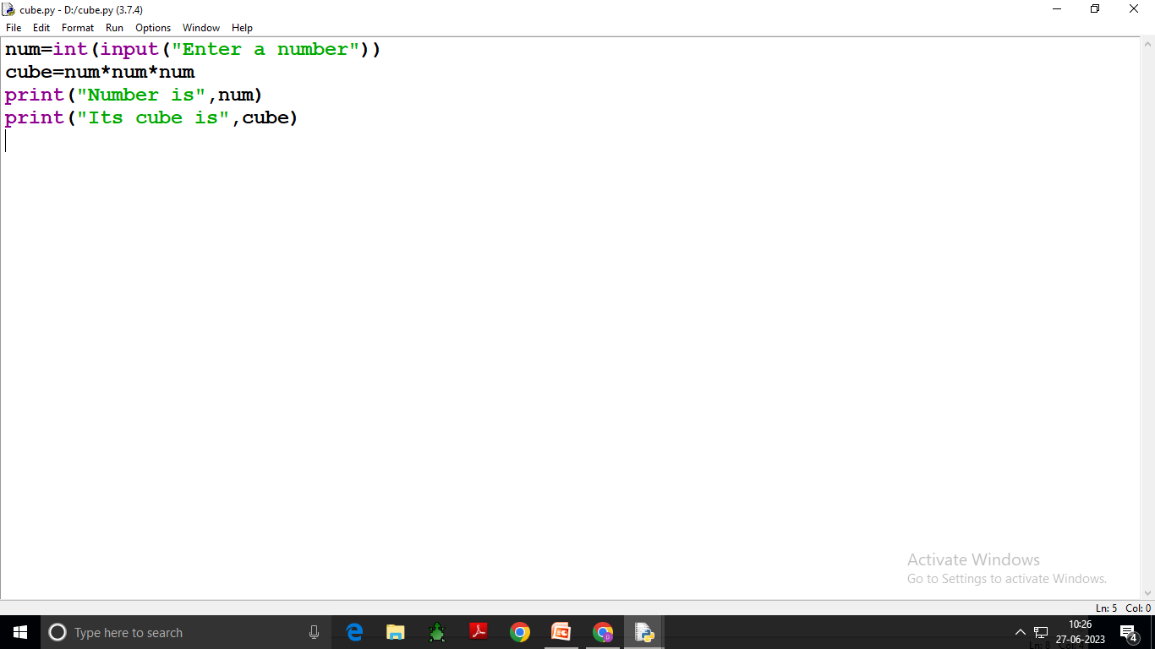

Slide 14
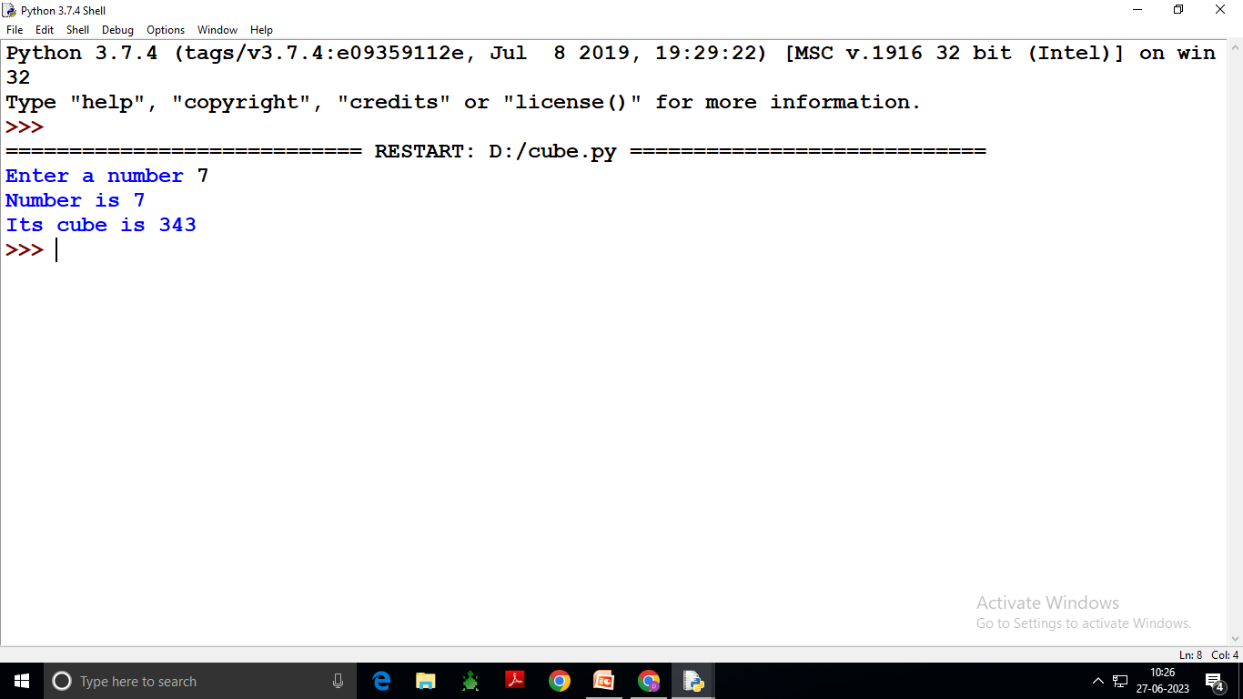

Slide 16
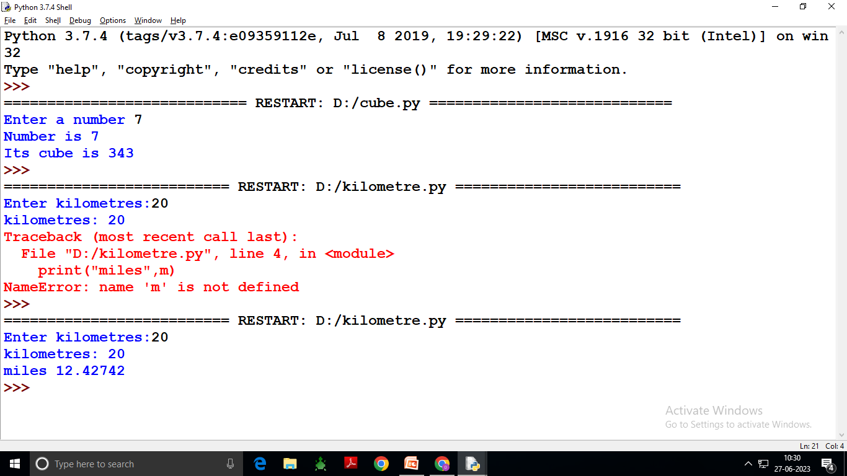

Slide 17
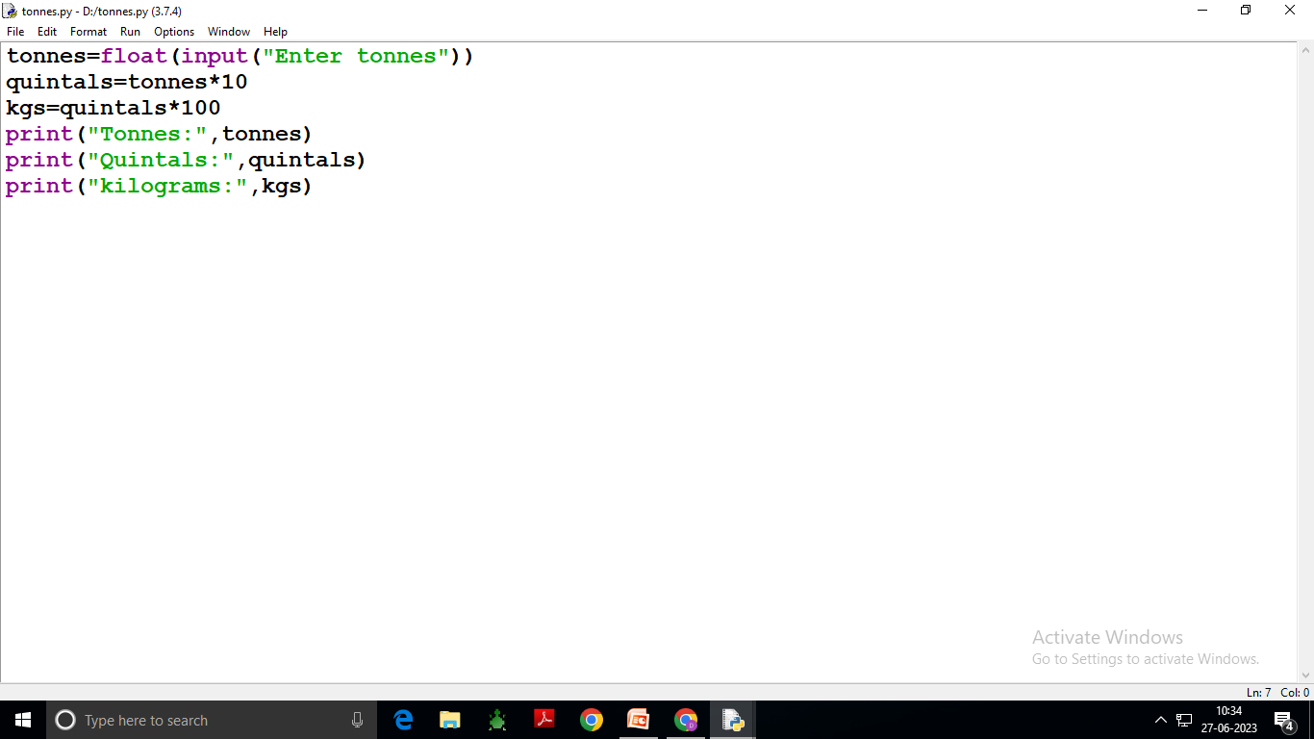

Slide 18
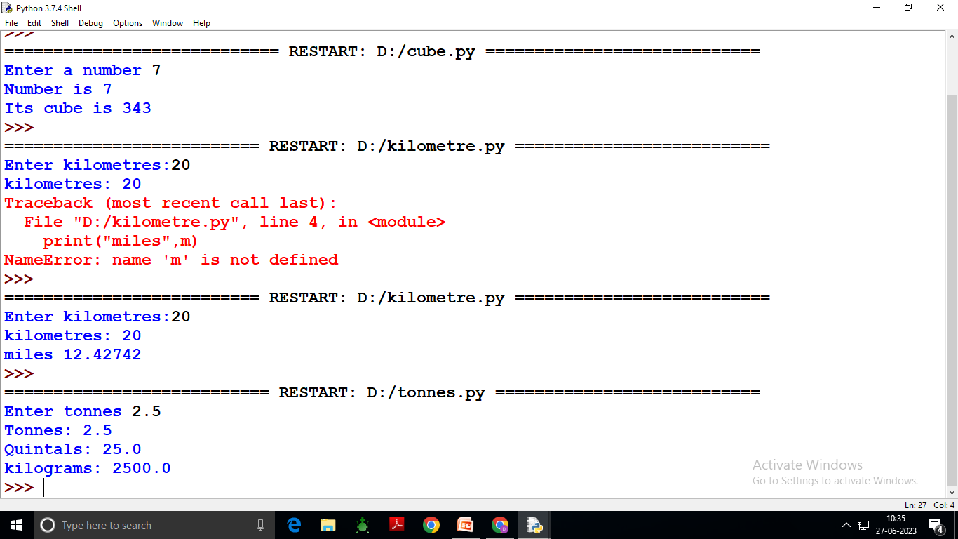

Slide 20
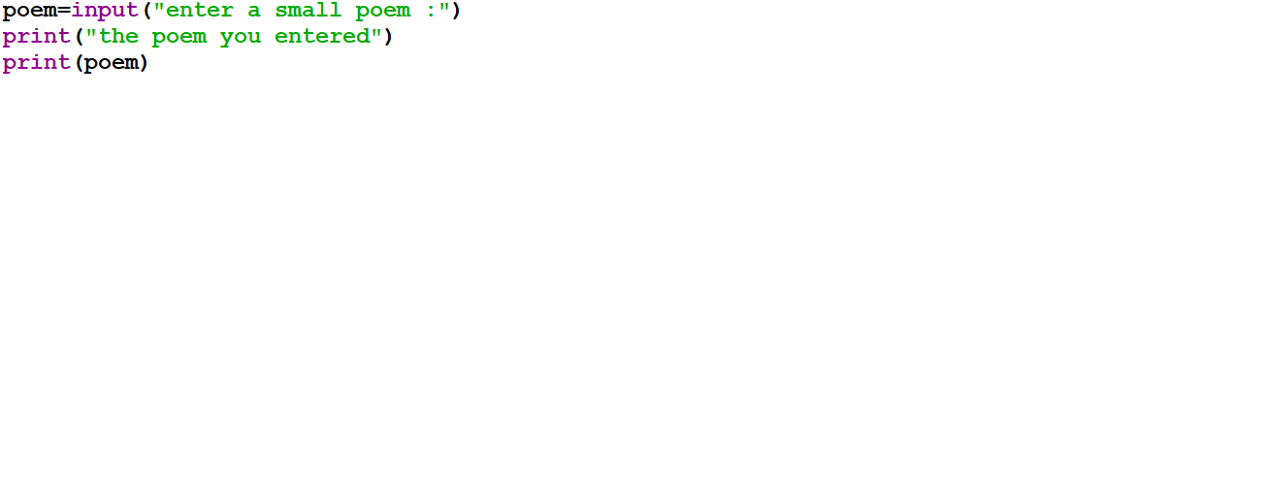

Slide 21
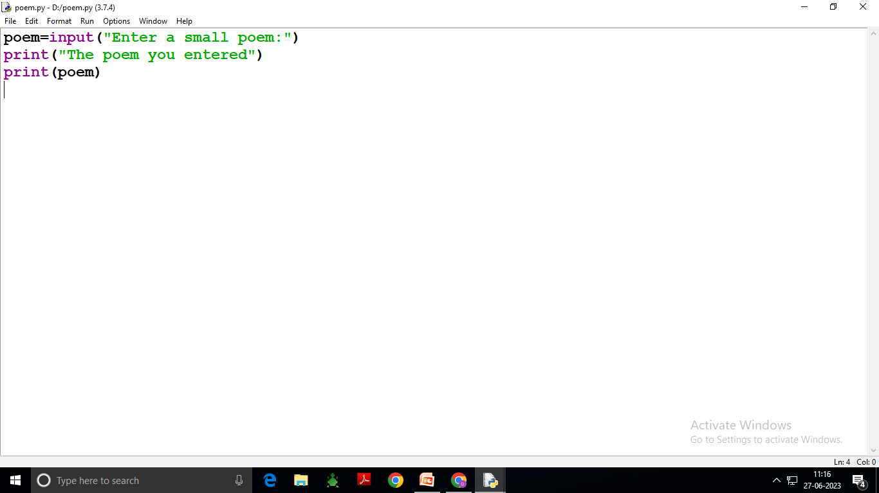

Slide 22
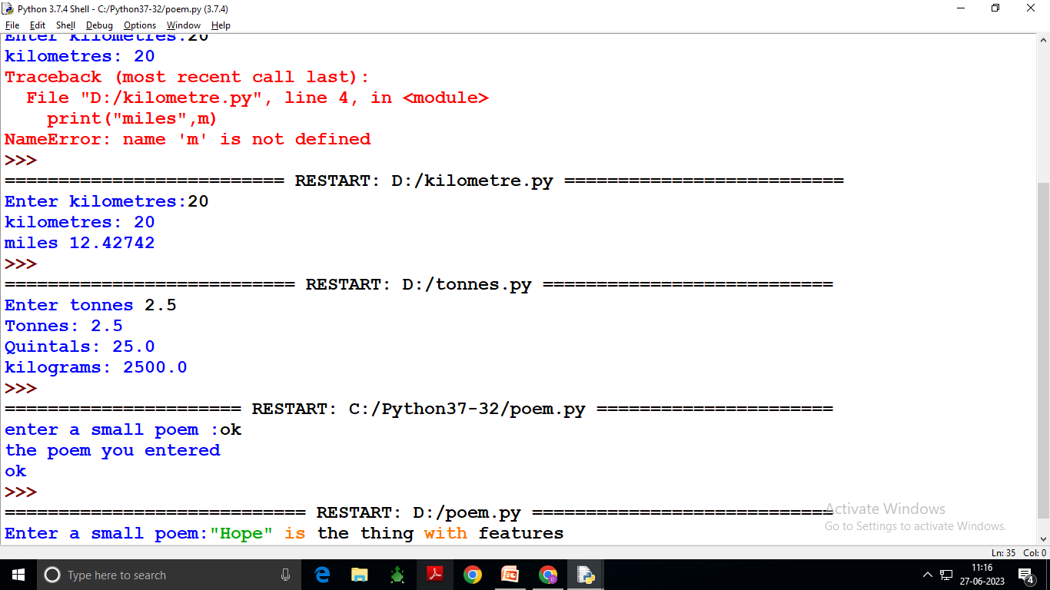

Slide 23
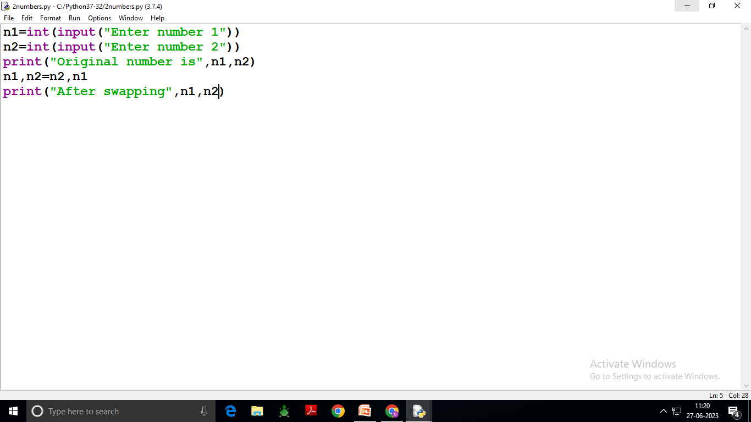

Slide 24
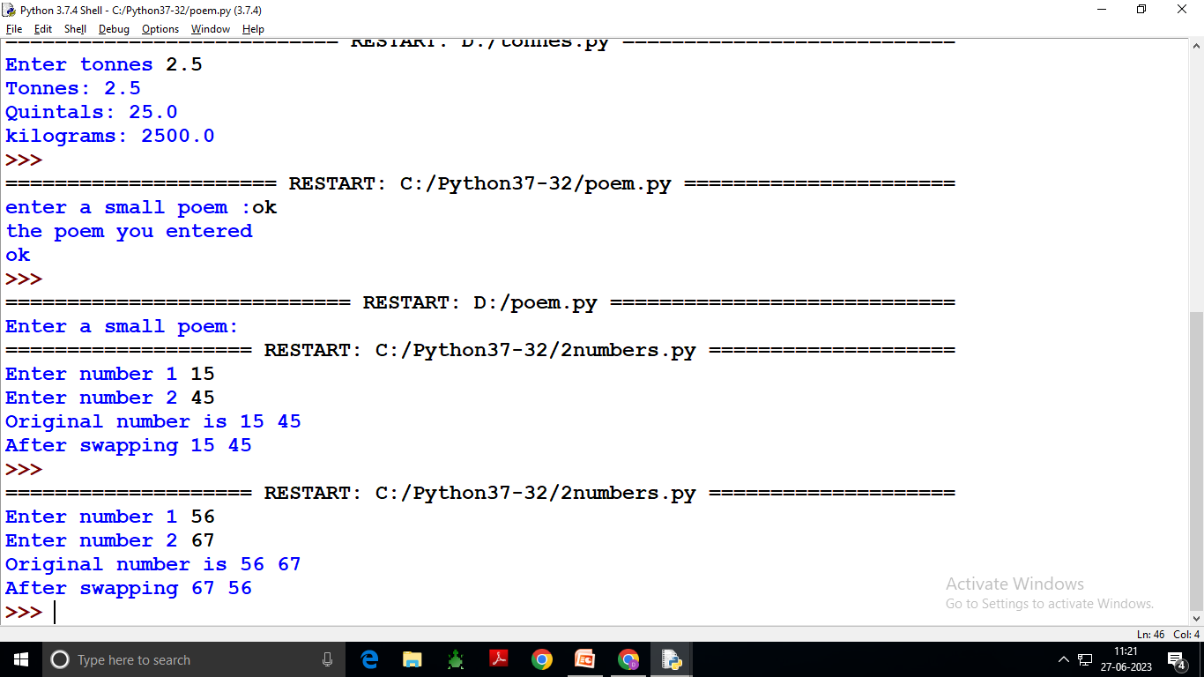

Slide 25
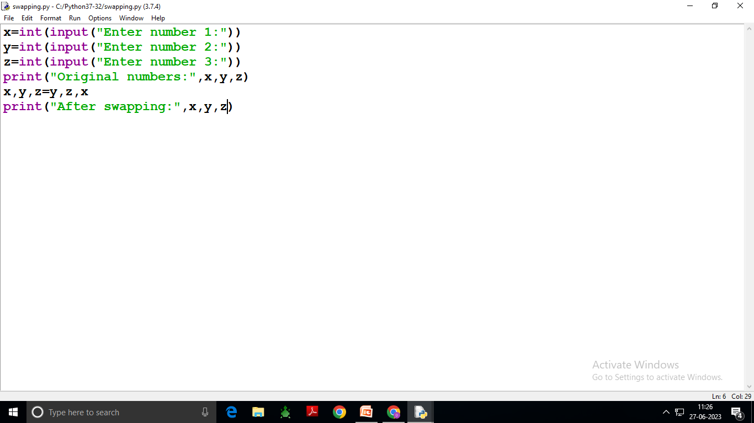

Slide 26
